Slide 1
The art of learning
Predict the housing price?
Predict the stock market price?
Spam classifiers?
Market segmentation?

Slide 2

o1
Machine Learning – Linear Regression

Slide 3
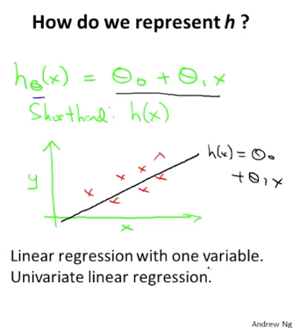
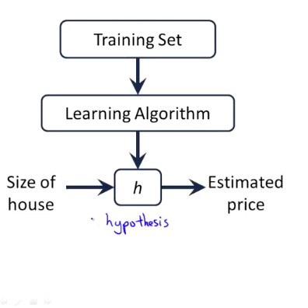
The Idea of learning:
x
Hypothesis
y

Slide 4
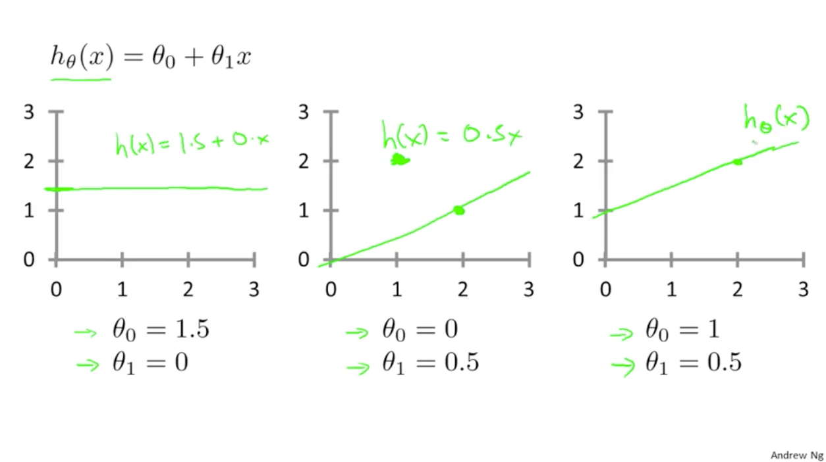

Slide 5
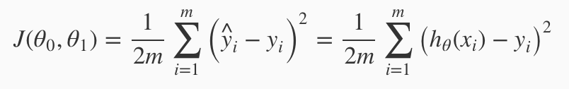
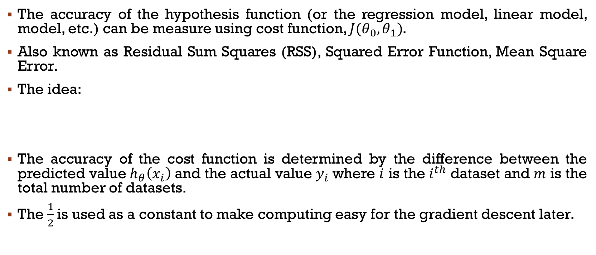
Cost function
The accuracy of the hypothesis function (or the regression model, linear model, model, etc.) can be measure using cost function, $J(θ_{0},θ_{1})$.
Also known as Residual Sum Squares (RSS), Squared Error Function, Mean Square Error.
The idea:
The accuracy of the cost function is determined by the difference between the predicted value $h_{θ}\left(x_{i}\right)$ and the actual value $y_{i}$ where $i$ is the $i^{th}$ dataset and $m$ is the total number of datasets.
The $\frac{1}{2}$is used as a constant to make computing easy for the gradient descent later.

Slide 7
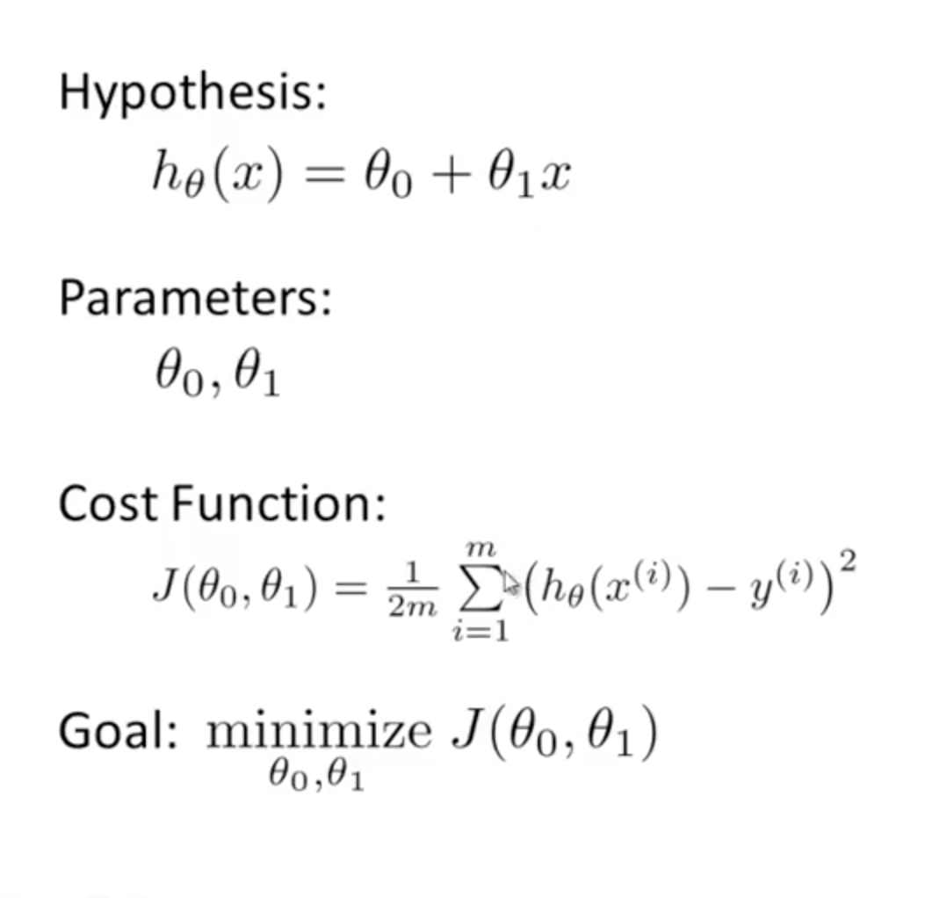

The concept of linear regression is as shown.
The objective is to generate a model that yield the smallest or lowest cost function value.
This means that the model is highly accurate.

Slide 8
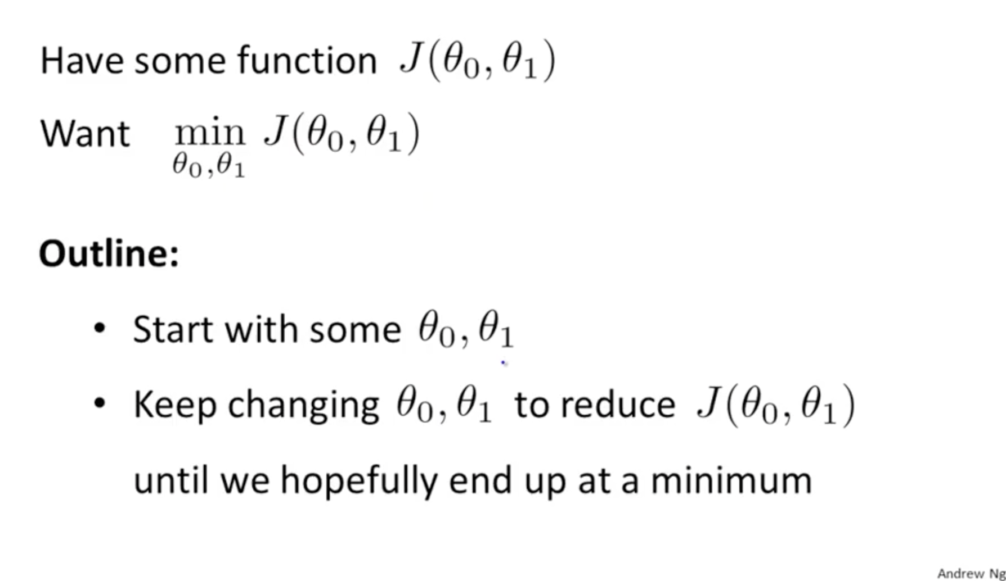

Slide 9
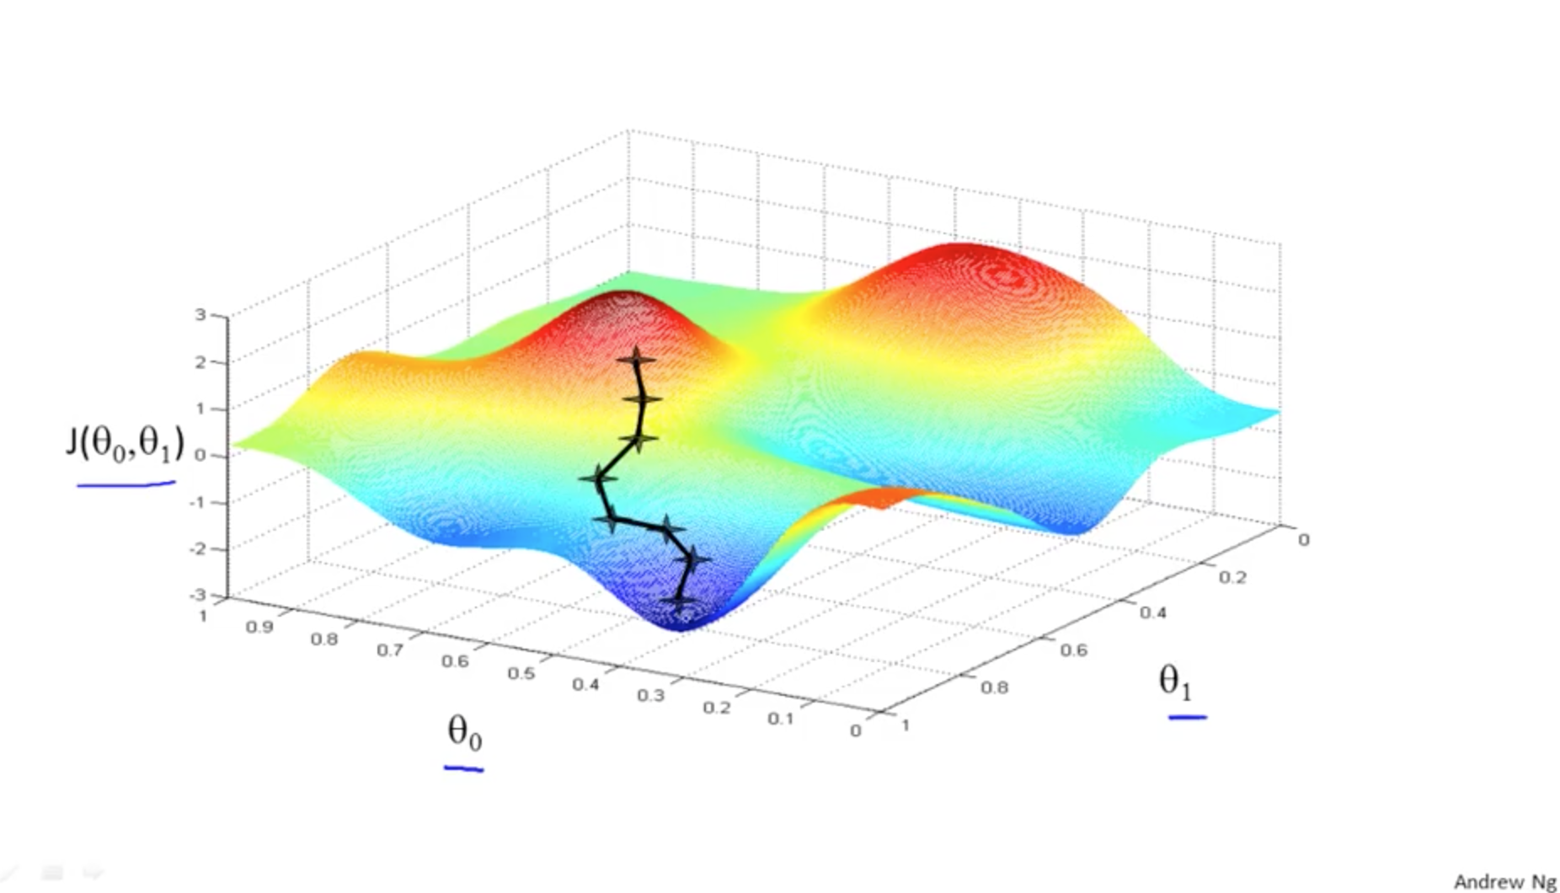

Slide 10
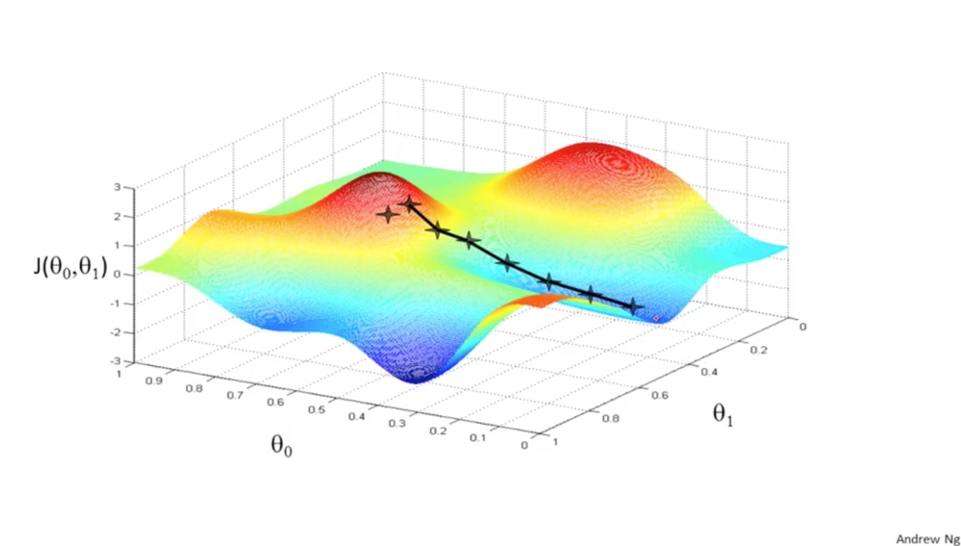
Notes:
A different $(θ_{0},θ_{1}$) initialization would give a different gradient descent but ultimately, leads to a minimum point.

Slide 11
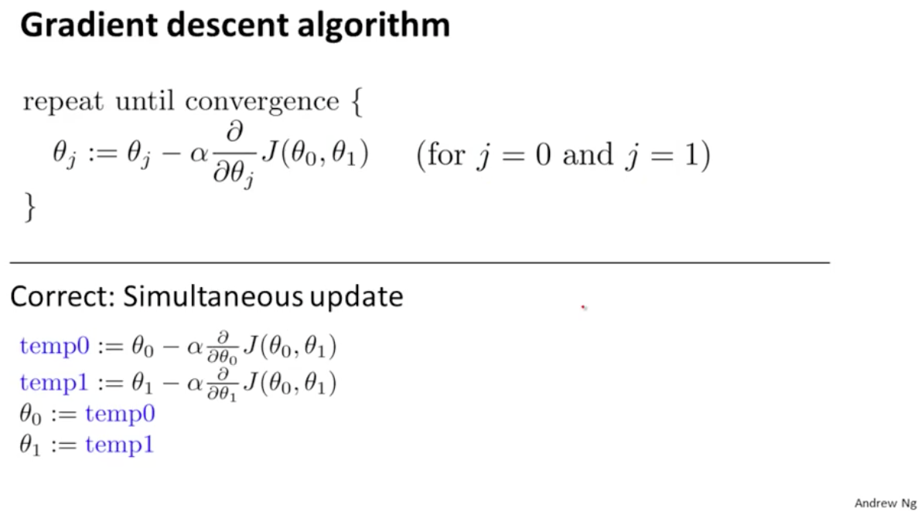
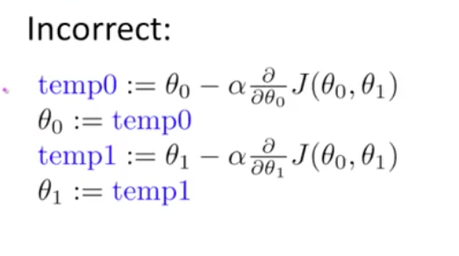
Gradient descent
Notes:
Alpha is the learning rate.
It is basically iteratively updating the theta0 and theta1 values after evaluating the cost function.
It is simultaneous update of theta0 and theta1 value. Else one will be updated first and the new value of theta would influence the other theta. WRONG.
Screen Shot 2017-11-20 at 2.05.22 PM

Slide 12
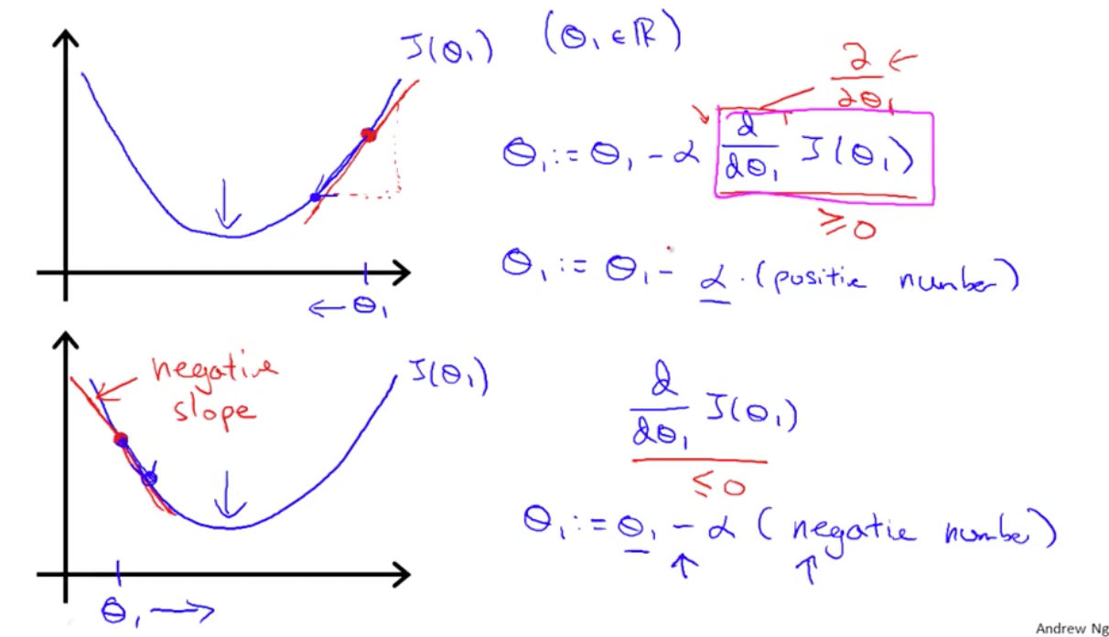
Gradient descent intuition
Notes:
Let’s consider an example with only theta1 and assume that theta0 is zero.
First: slope is positive slope as (small y – big y)/(small x – big x).
Second: slope is negative slope as (small y – big y)/(big x - small x).
This is from the concept of new value – old value.

Slide 13
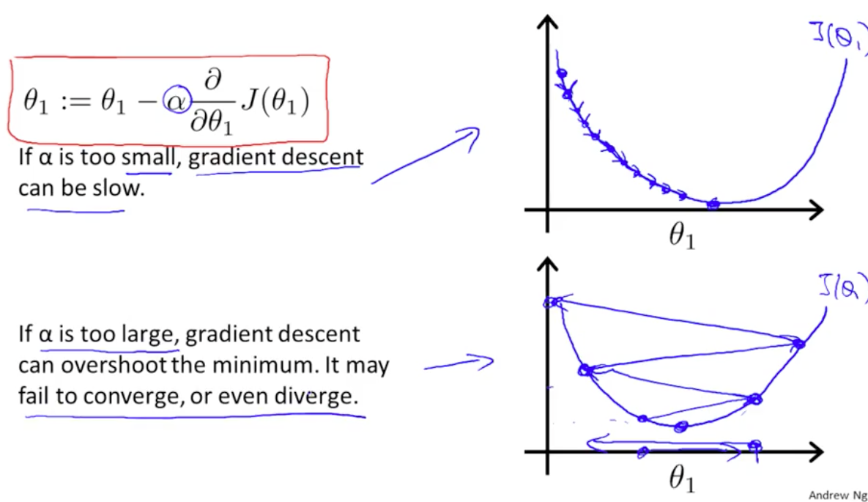
The 𝛂
One way to check if alpha value is optimal value: plot cost function vs. iteration and check for the convergence/saturation point.
Notes:
When to stop the gradient descent? When the cost function value doesn’t change much.

Slide 14
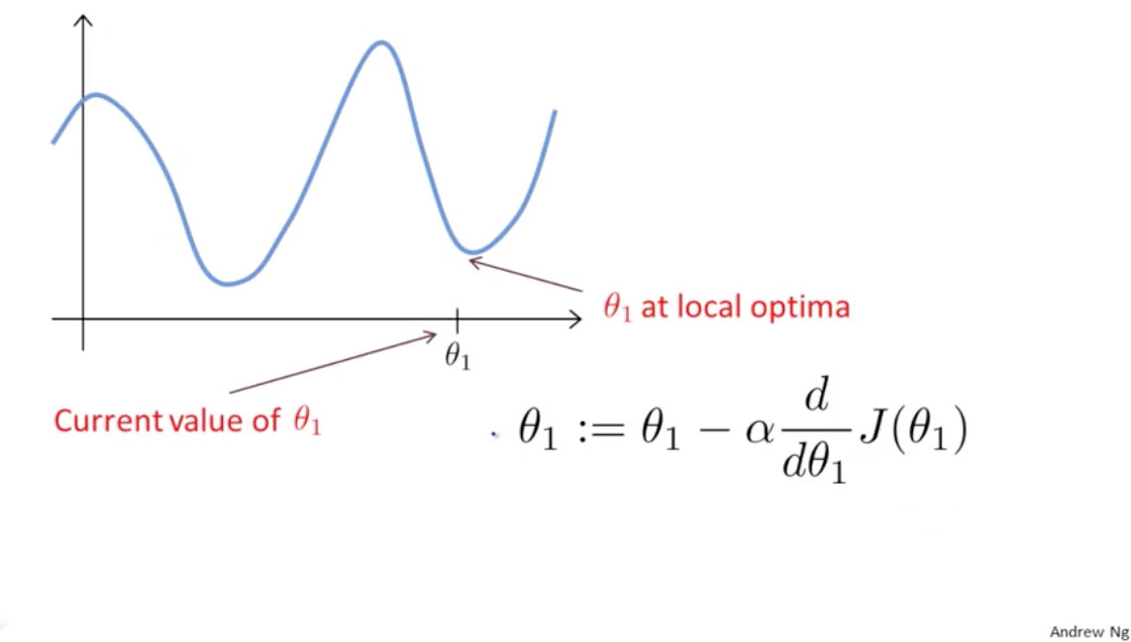
Some considerations
Notes:
What happens when gradient descent is at a local optima or initialized at a local optima.
In this case, the theta1 value will not change as the derivative value is zero i.e. the slope is zero.
As you reach the minimum point, the steps taken gradually becomes smaller.

Slide 15
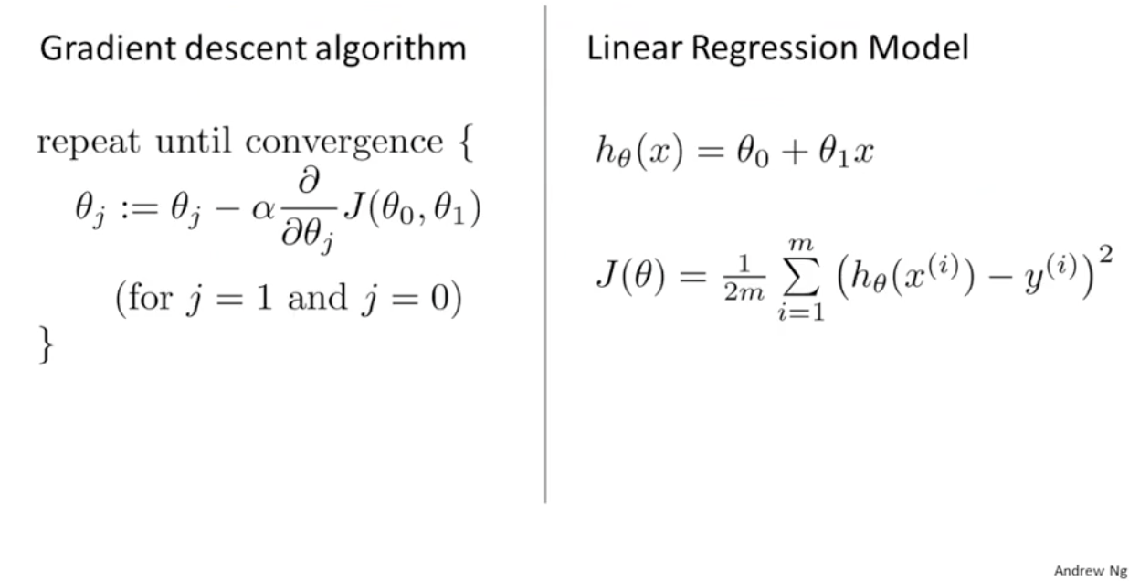
Gradient descent into linear regression model
Notes:
This is the overview of the gradient descent algorithm and the linear regression model.

Slide 16
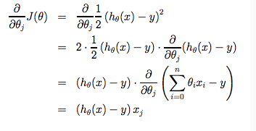
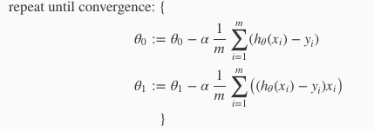
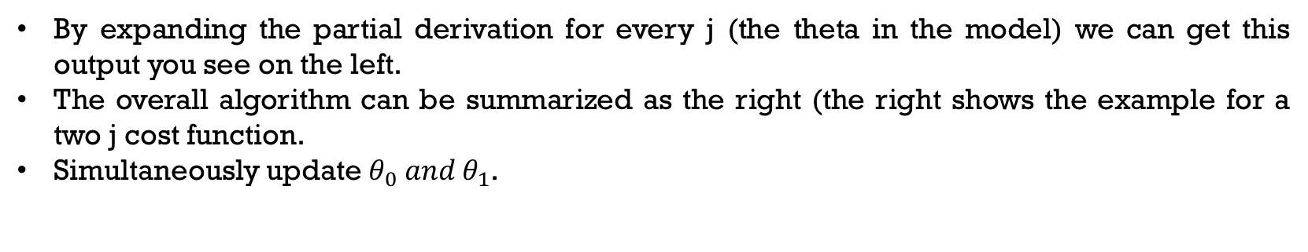
Linear regression model
By expanding the partial derivation for every j (the theta in the model) we can get this output you see on the left.
The overall algorithm can be summarized as the right (the right shows the example for a two j cost function.
Simultaneously update $θ_{0} and θ_{1}$.

Slide 17
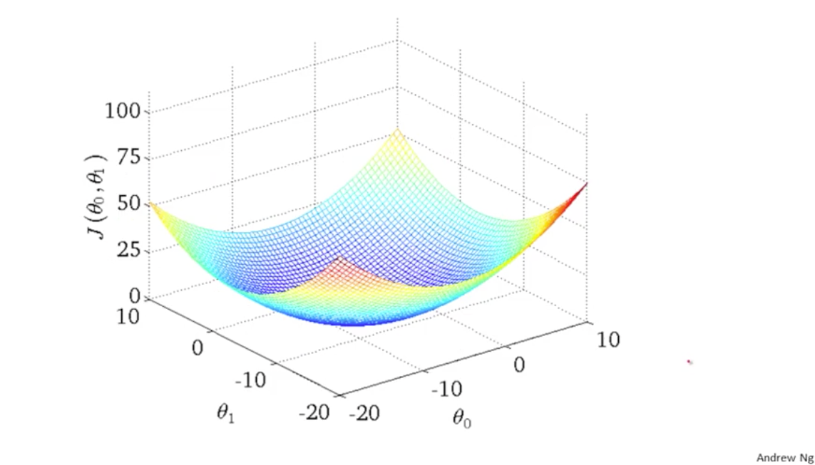
Local minima vs. global minima
Notes:
Depending on what are the initial theta0 and 1 values, the cost function can end up at different local minima.
But for cost function for linear regression is always going to be a convex function: bowl-shape function.
There are no local optima, only global.

Slide 18
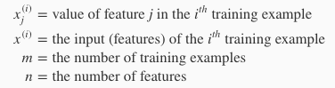
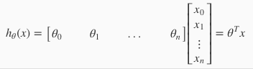
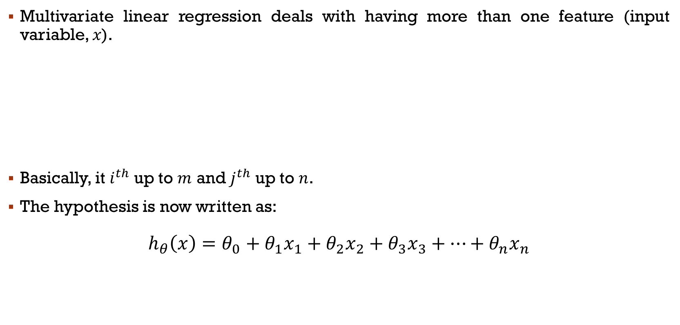
Multivariate linear regression
Multivariate linear regression deals with having more than one feature (input variable, 𝑥).
Basically, it $i^{th}$ up to $m$ and $j^{th}$ up to $n$.
The hypothesis is now written as:
$$h_{θ}\left(x\right)=θ_{0}+θ_{1}x_{1}+θ_{2}x_{2}+θ_{3}x_{3}+…+θ_{n}x_{n}$$
Notes:
Transpose theta because x and theta is written in vector form.

Slide 19
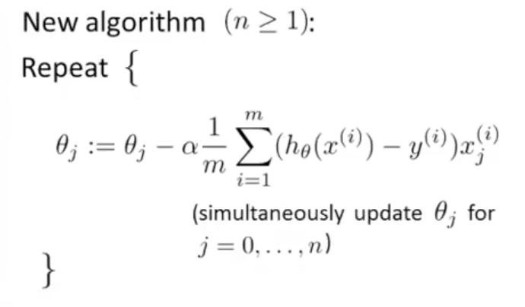
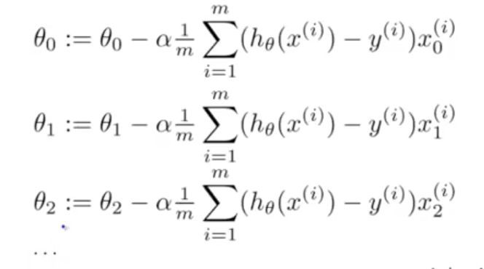
Multivariate gradient descent
Simultaneous update of all theta values using gradient descent.

Slide 20
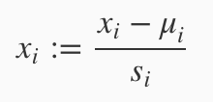
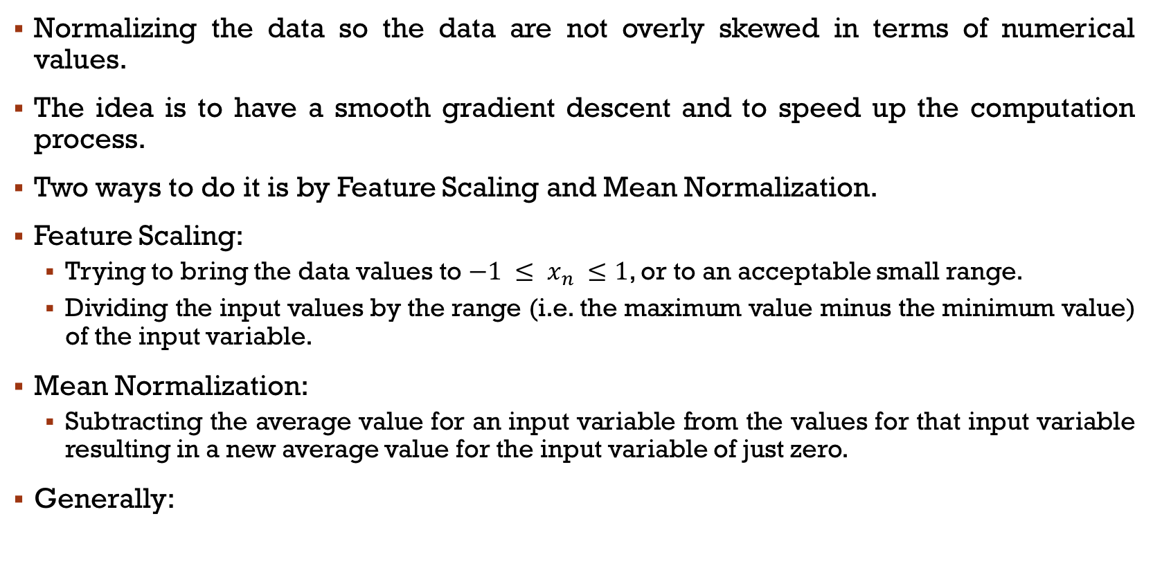
Normalizing the data
Normalizing the data so the data are not overly skewed in terms of numerical values.
The idea is to have a smooth gradient descent and to speed up the computation process.
Two ways to do it is by Feature Scaling and Mean Normalization.
Feature Scaling:
Trying to bring the data values to $−1 ≤ x_{n} ≤1$, or to an acceptable small range.
Dividing the input values by the range (i.e. the maximum value minus the minimum value) of the input variable.
Mean Normalization:
Subtracting the average value for an input variable from the values for that input variable resulting in a new average value for the input variable of just zero.
Generally:

Slide 21
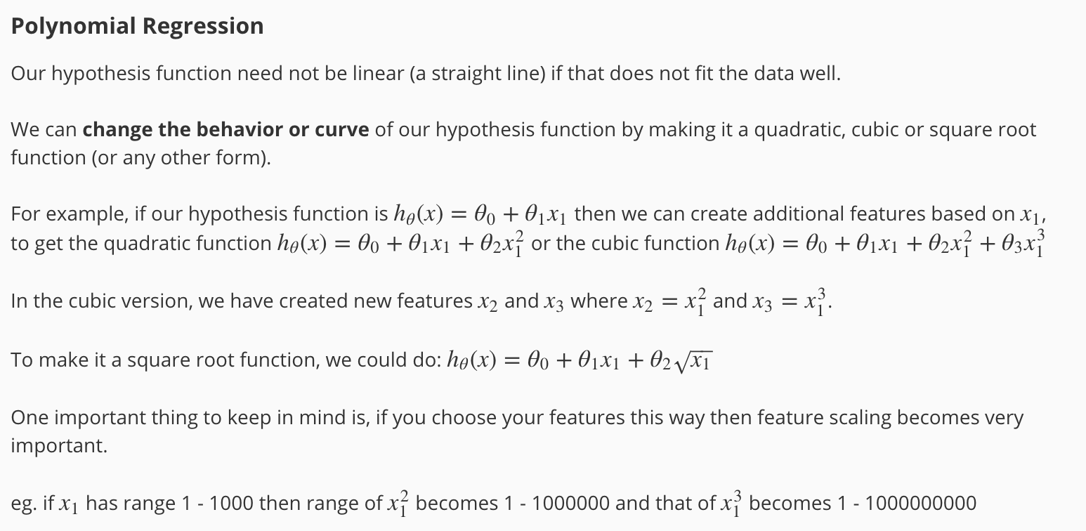
Polynomial regression

Slide 22
o2
Machine Learning – Logistic Regression

Slide 23
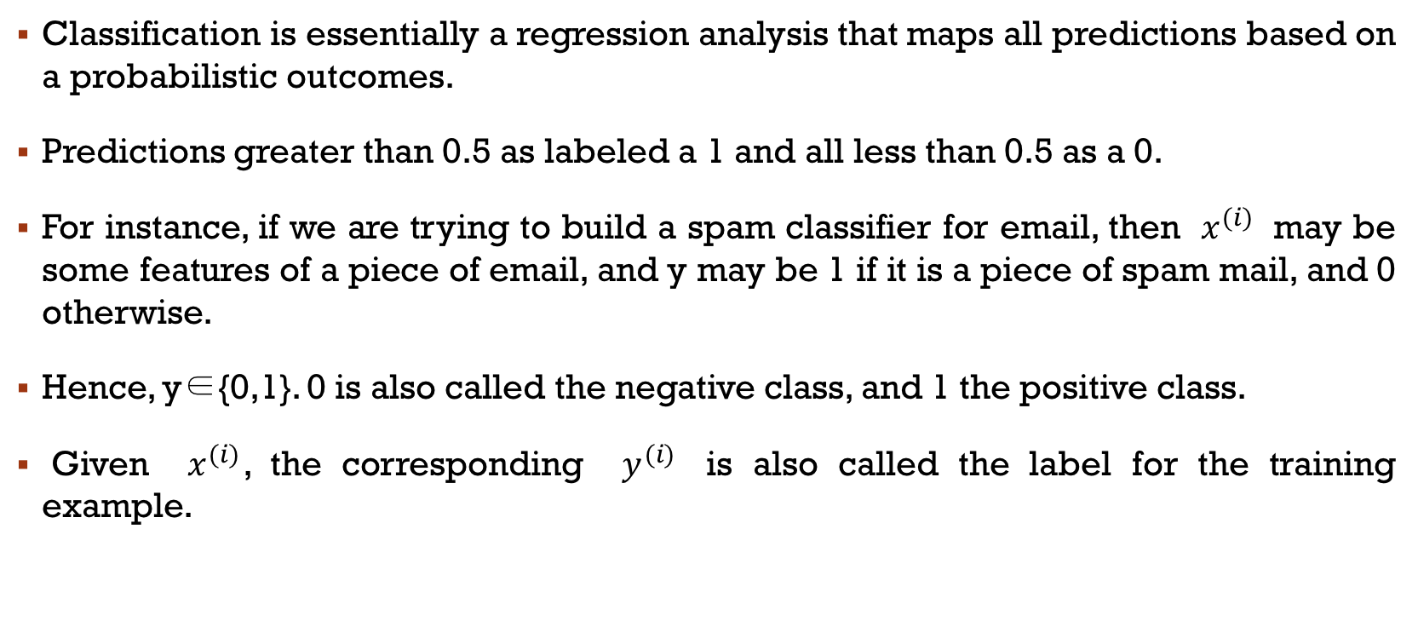
Classification: Logistic regression
Classification is essentially a regression analysis that maps all predictions based on a probabilistic outcomes.
Predictions greater than 0.5 as labeled a 1 and all less than 0.5 as a 0.
For instance, if we are trying to build a spam classifier for email, then $x^{(i)}$ may be some features of a piece of email, and y may be 1 if it is a piece of spam mail, and 0 otherwise.
Hence, y∈{0,1}. 0 is also called the negative class, and 1 the positive class.
Given $x^{(i)}$, the corresponding $y^{(i)}$ is also called the label for the training example.

Slide 24
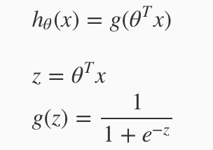
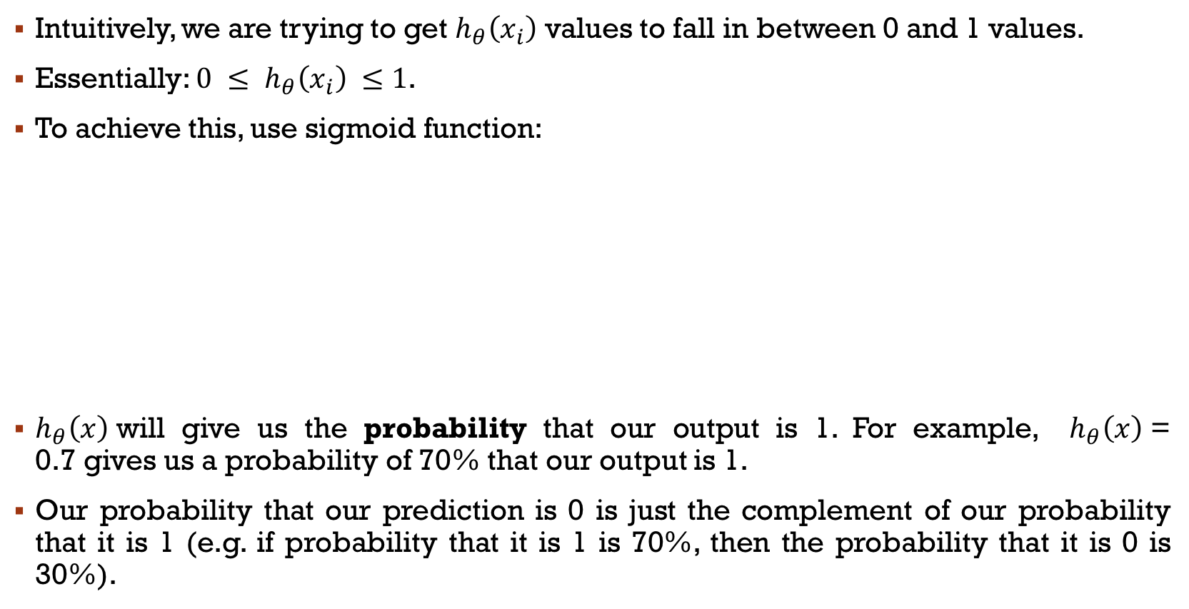
Cont.
Intuitively, we are trying to get $h_{θ}\left(x_{i}\right)$ values to fall in between 0 and 1 values.
Essentially: $0 ≤ h_{θ}\left(x_{i}\right) ≤1$.
To achieve this, use sigmoid function:
$h_{θ}\left(x\right)$will give us the probability that our output is 1. For example, $h_{θ}\left(x\right)$= 0.7 gives us a probability of 70% that our output is 1.
Our probability that our prediction is 0 is just the complement of our probability that it is 1 (e.g. if probability that it is 1 is 70%, then the probability that it is 0 is 30%).

Slide 25
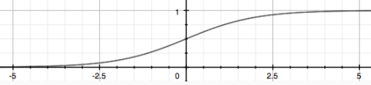
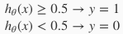
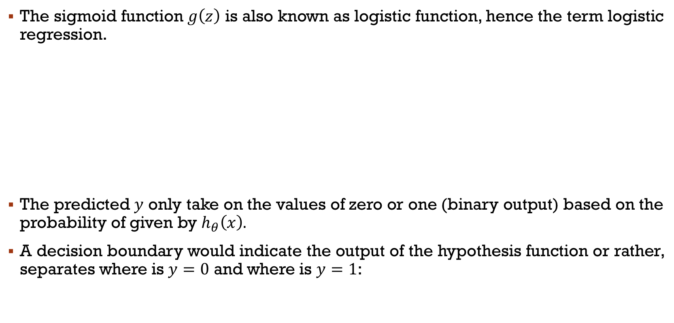
Sigmoid function
The sigmoid function $g\left(z\right)$ is also known as logistic function, hence the term logistic regression.
The predicted $y$ only take on the values of zero or one (binary output) based on the probability of given by $h_{θ}\left(x\right).$
A decision boundary would indicate the output of the hypothesis function or rather, separates where is $y=0$ and where is $y=1$:

Slide 26
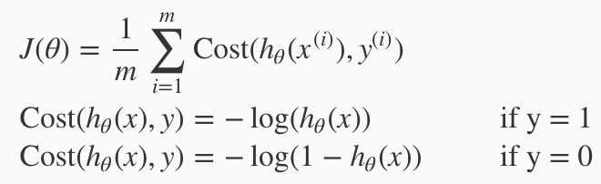
Logistic cost function
The cost function for logistic regression performs similar function as cost function for linear regression.
However, the math is slightly different. Have a look:
This new cost function is in logscale as to prevent the occurrences of many local optima which may arise if the linear cost function is used.

Slide 27
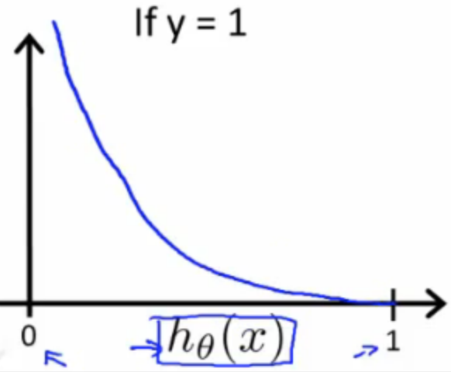
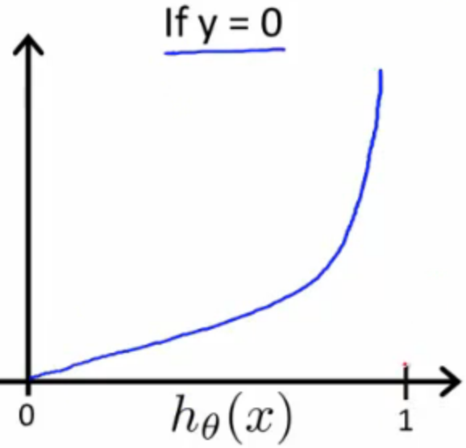
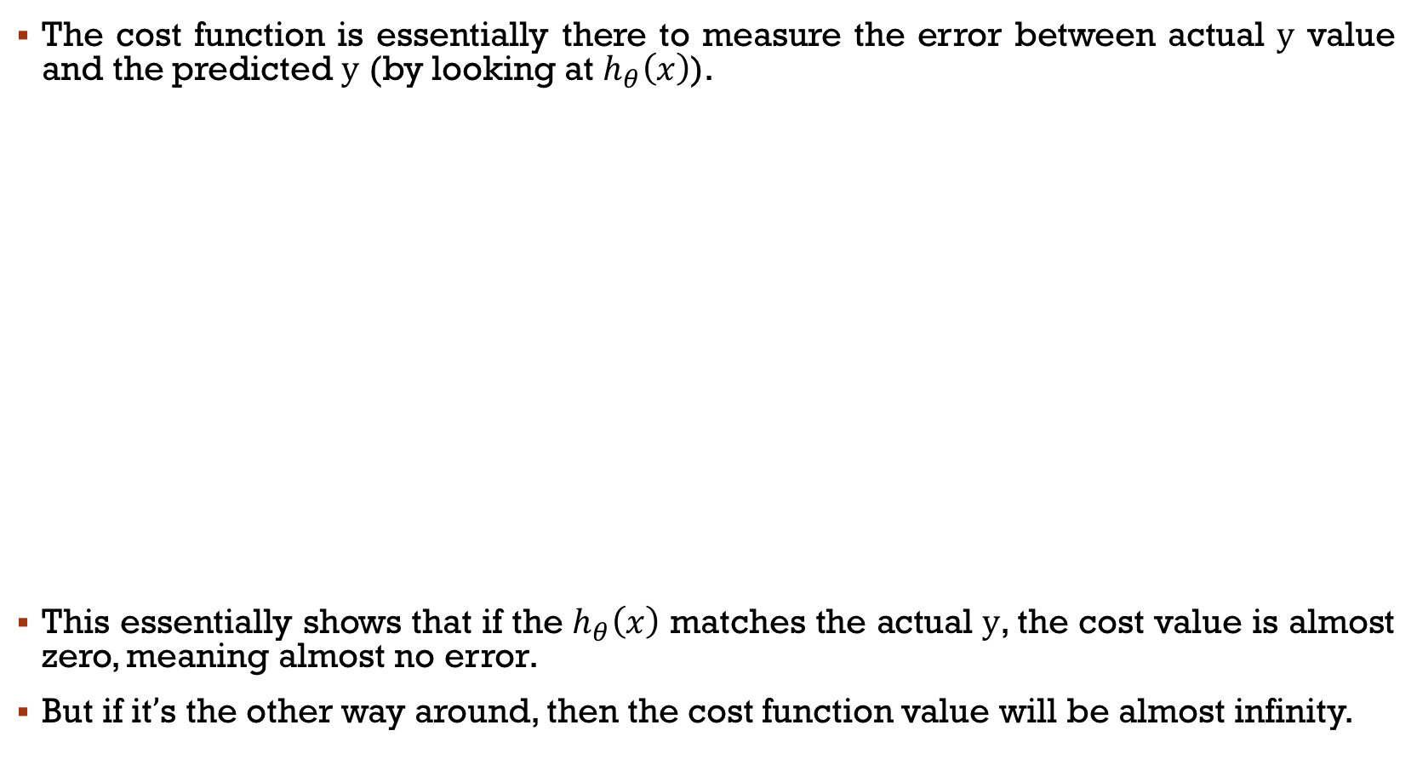
The cost function behavior
The cost function is essentially there to measure the error between actual $y$ value and the predicted $y$ (by looking at $h_{θ}\left(x\right)$).
This essentially shows that if the $h_{θ}\left(x\right)$ matches the actual $y$, the cost value is almost zero, meaning almost no error.
But if it’s the other way around, then the cost function value will be almost infinity.

Slide 28
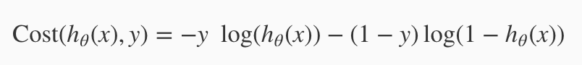
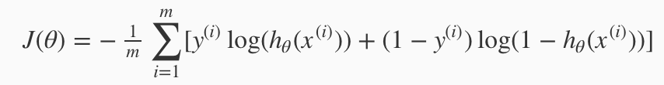
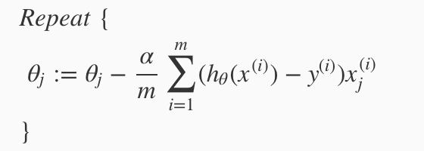
Cost function computation
The cost function can then be summarized as follow:
The cost function computation can be finalized as:
The gradient descent algorithm is:

Slide 29
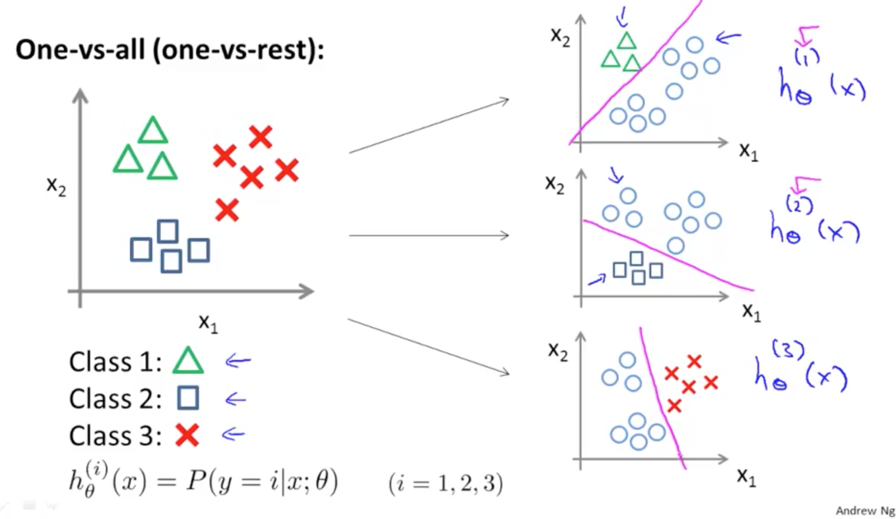
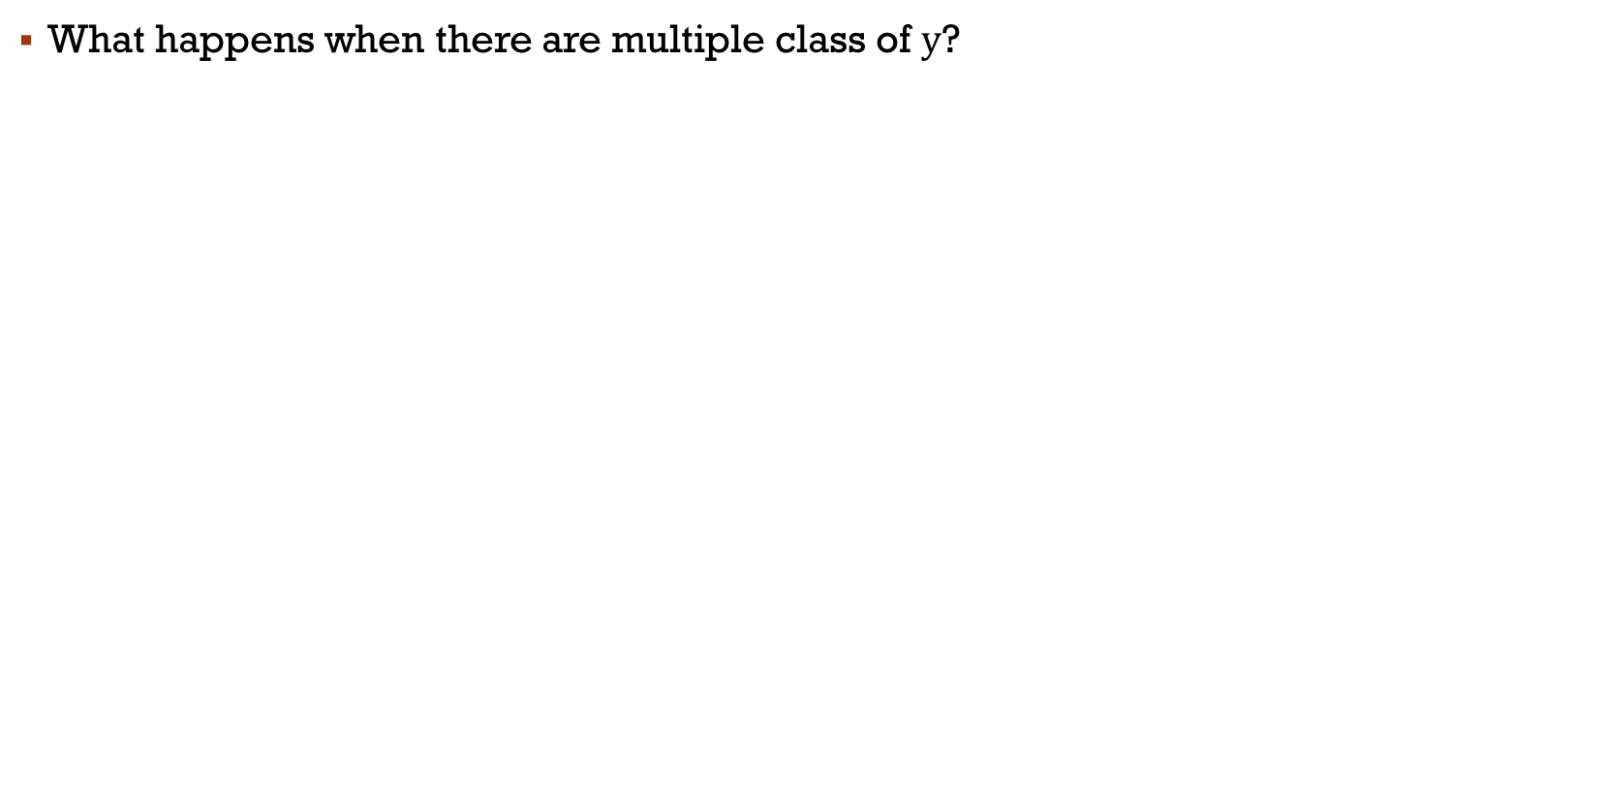
Multivariate logistic regression
What happens when there are multiple class of $y$?

Slide 30
o3
Machine Learning – Considerations: Regularization

Slide 31
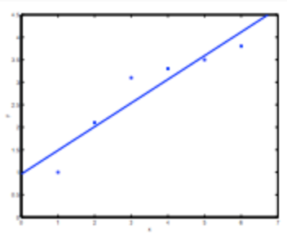
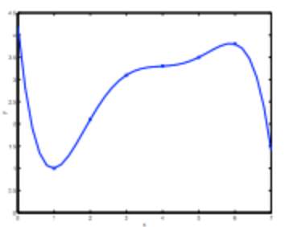
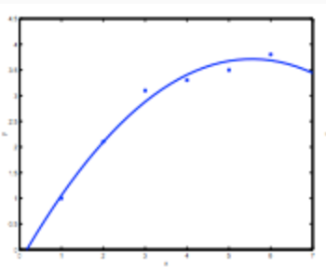
fitting
One of the main concern in regression analysis is the find the perfect line or fit for the available data.
This could lead to two main things: overfitting and underfitting.
How to solve this and get perfect fit?
Underfitting – leads to high bias
Overfitting – leads high variance
Perfect fit
Notes:
This usually happens when the model is too complex (i.e. too many features/variables compared to the number of observations)

Slide 32
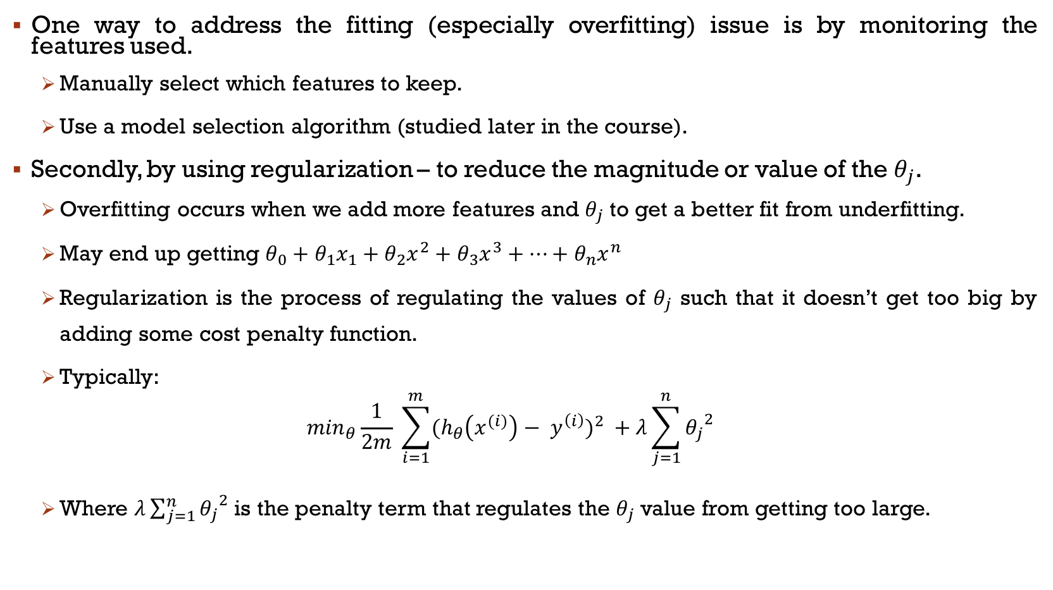
regularization
One way to address the fitting (especially overfitting) issue is by monitoring the features used.
Manually select which features to keep.
Use a model selection algorithm (studied later in the course).
Secondly, by using regularization – to reduce the magnitude or value of the $θ_{j}$.
Overfitting occurs when we add more features and $θ_{j}$ to get a better fit from underfitting.
May end up getting $θ_{0}+θ_{1}x_{1}+θ_{2}x^{2}+θ_{3}x^{3}+…+θ_{n}x^{n}$
Regularization is the process of regulating the values of $θ_{j}$ such that it doesn’t get too big by adding some cost penalty function.
Typically:
$$\min_{θ}\frac{1}{2m} \sum_{i=1}^{m}{{{(h}_{θ}\left(x^{(i)}\right)− y^{\left(i\right)})}^{2}} +λ\sum_{j=1}^{n}{{θ_{j}}^{2}}$$
Where $λ\sum_{j=1}^{n}{{θ_{j}}^{2}}$ is the penalty term that regulates the $θ_{j}$ value from getting too large.
Notes:
Some $θ_{j}$ make be infinitely closer to zero such that it can be ignored.
So a 4 degree polynomial maybe just become 2 degrees.

Slide 33
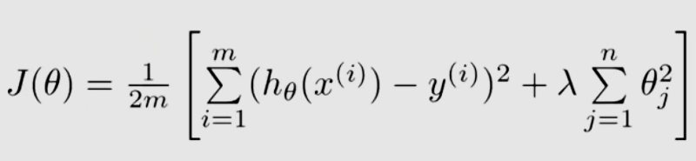
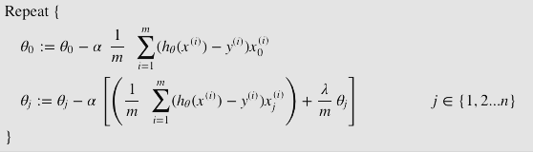
Regularized linear regression
By adding regularization in cost function:
As for the gradient descent:

Slide 34
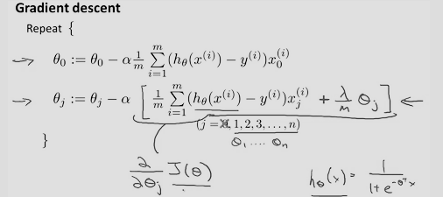
Regularized logistic regression
By adding regularization in cost function:
As for the gradient descent:

Slide 35
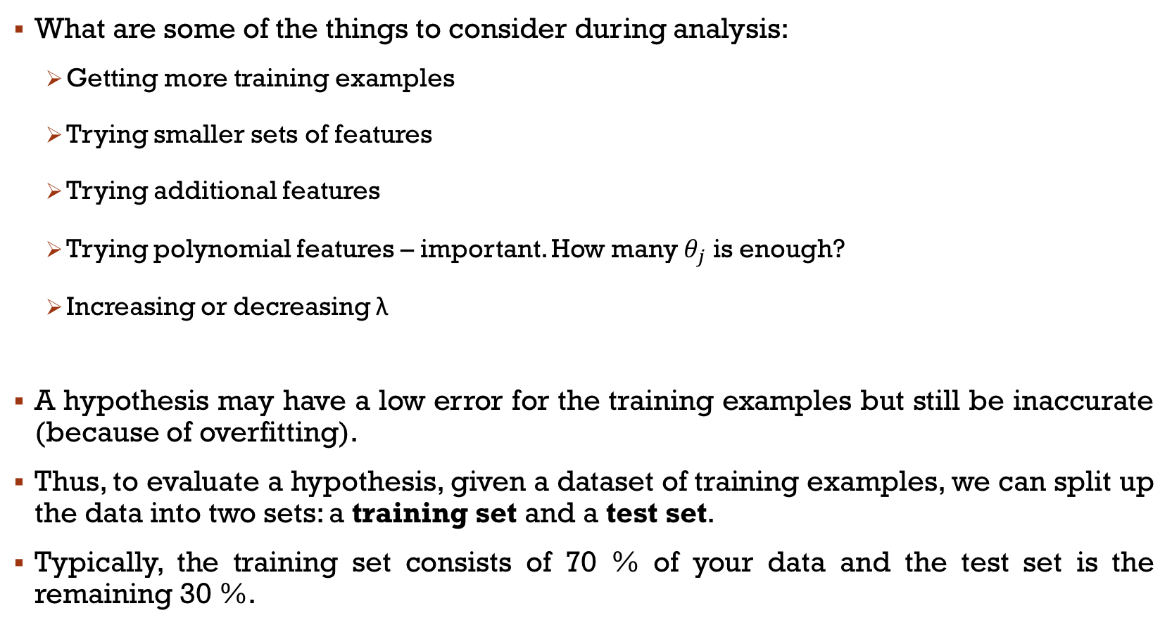
Model selection problem
What are some of the things to consider during analysis:
Getting more training examples
Trying smaller sets of features
Trying additional features
Trying polynomial features – important. How many $θ_{j}$ is enough?
Increasing or decreasing λ
A hypothesis may have a low error for the training examples but still be inaccurate (because of overfitting).
Thus, to evaluate a hypothesis, given a dataset of training examples, we can split up the data into two sets: a training set and a test set.
Typically, the training set consists of 70 % of your data and the test set is the remaining 30 %.

Slide 36
o3
Machine Learning – Considerations: CrossValidation

Slide 37

Train, test and cross validate
Why need to split data?
Consider two different approach?
Two way split – Train first then test.
Three way split – Train first, validate it and then test it.
Basically:

Slide 38


How does this work?
Assume that we have up to n-degree hypothesis.
Find the hypothesis, $h_{θ}\left(x\right)$ for the individual degree polynomial. That means getting the final $h_{θ}\left(x\right)$ when cost function value plateaus.
Compare the cost function for the individual $h_{θ}\left(x\right)$ during the testing or cross-validation step.

Slide 39

basically
We want to get this plot:

Slide 40
o4
Machine Learning – The Accuracy

Slide 41


Classification error & Accuracy
Error measures fraction of mistakes made in classification:
(Best possible value: 0.0)
Accuracy measures the fraction of correct predictions:
(Best possible value: 1.0)

Slide 42

What’s a good accuracy?

Slide 43

Is 90% accuracy good? Depends...

Slide 44

Ask the hard questions...

Slide 45

Types of Errors

Slide 46

Types of Errors
Positive = Pregnant
Negative = Not pregnant

Slide 47

Cost of different types of mistakes
Different (and high) in some applications!

Slide 48

Confusion matrix - binary
Test set: 100 samples
Accuracy = ?
50
10
5
35

Slide 49

Confusion matrix - multiclass
Test set: 100 samples
Accuracy = ?
60
8
2
4
12
4
0
₄₂
8

Slide 50



Precision, Recall

Slide 51


Precision-Recall Curve
This is where you want your performance to be!
Better if the curve goes
diagonally higher

Slide 52

Precision-Recall Curve
Can be extended to multiclass case
⇒ You get separate P-R curves for each class!

